Slide 1
What is Machine Learning?
The name does sound fancy!

Slide 2
RECOMMENDED READING:
“The Machine Learning Revolution”, The Machine Learning Revolution, Pedro Domingos (Chapter 1, pgs 1 - 22)
“The Machine Learning Landscape”, Hands -On Machine Learning with Scikit-Learn, Keras & TensorFlow (Chapter 1, pgs 1-34).
RECOMMENDED VIDEOS:
What is Machine Learning?, Google Cloud Platform (5:22 min) - https://www.youtube.com/watch?v=HcqpanDadyQ
Intro to Machine Learning (ML Zero to Hero - Part 1), Tensorflow (7:17 min) - https://www.youtube.com/watch?v=KNAWp2S3w94
A Gentle Introduction to Machine Learning, StatQuest (12:44 min) - https://www.youtube.com/watch?v=Gv9_4yMHFhI&t=0s

Slide 3
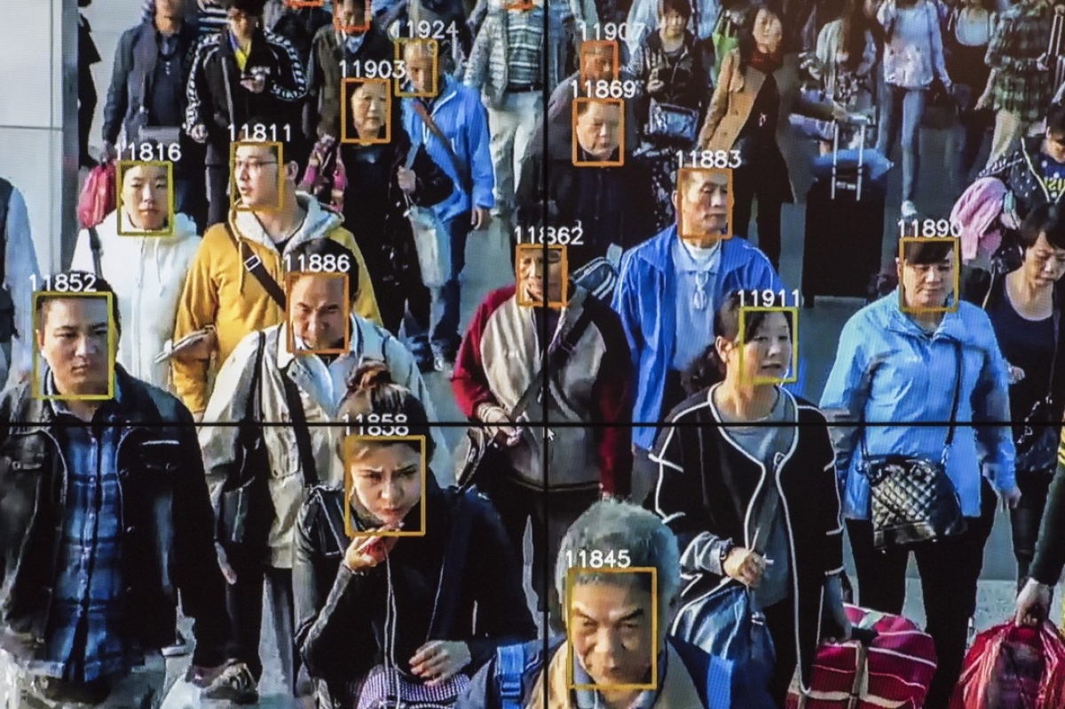

Slide 4
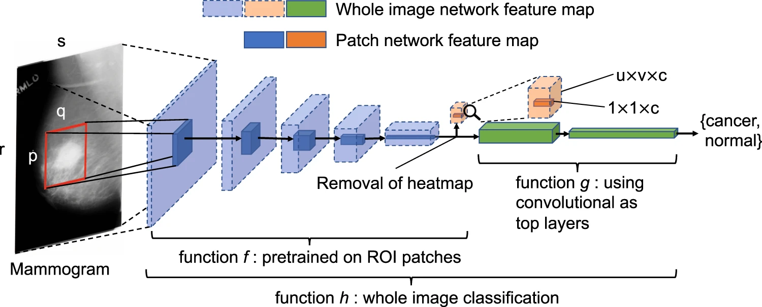
Notes:
Takeaway: in some cases, the most important part of ML is how to process / transform the data before any actual “AI” takes place.

Slide 5
What’s ML?
Seen as a subset of AI. ML algorithms build a model based on sample data (training data), in order to make predictions without being explicitly programmed to do so.
A field of study that gives computers the ability to learn without being explicitly programmed.

Slide 6
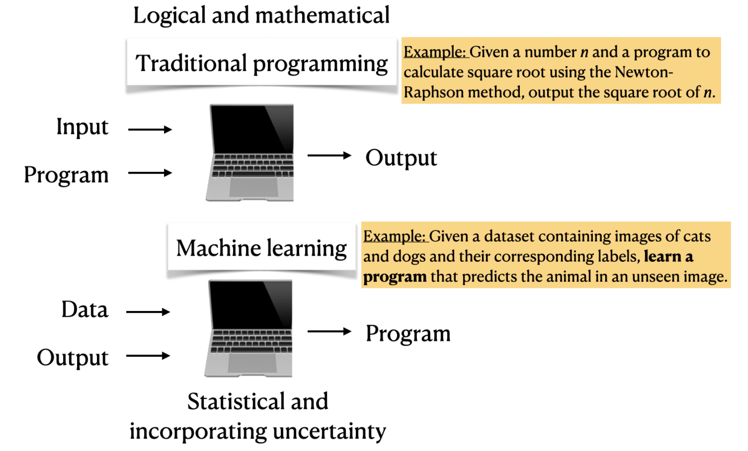
Traditional programming vs Machine Learning

Slide 7

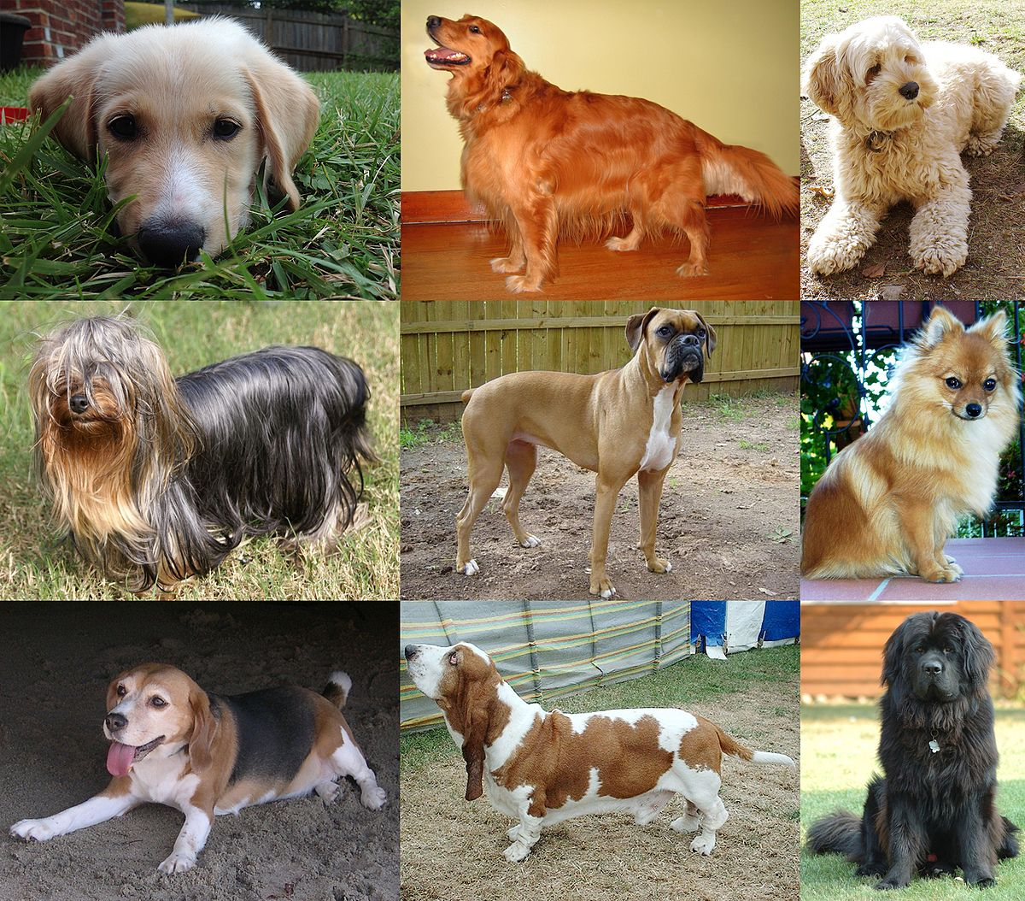
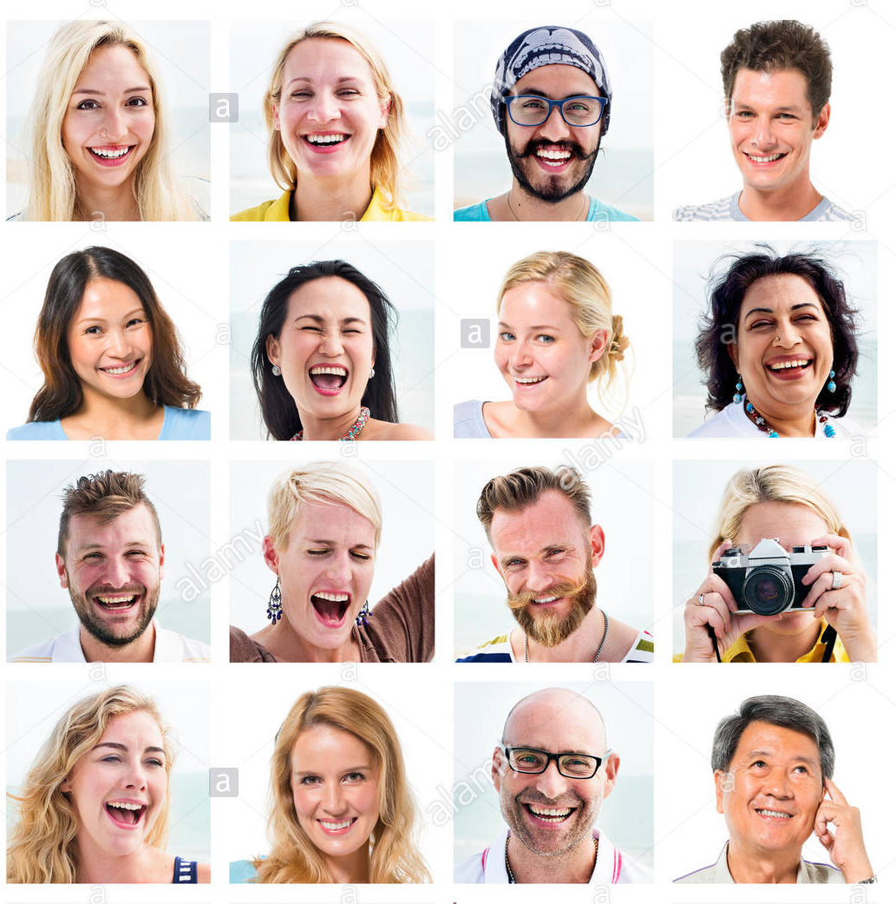
Traditional programming vs Machine Learning
if 4 paws AND furry AND (FURRY = WHITE|BLACK|BROWN) AND … THEN dog
computer
DOG
if 2 legs AND NOT furry AND wears clothes
AND … THEN human
HUMAN
HUMAN
HUMAN
HUMAN
DOG
DOG
DOG
MODEL
HUMAN
HUMAN
HUMAN
HUMAN
computer
DOG
DOG
DOG
HUMAN
HUMAN
HUMAN
HUMAN
DOG
DOG
DOG
HUMAN
HUMAN
HUMAN
HUMAN

Slide 8
Types of Machine Learning

Slide 9
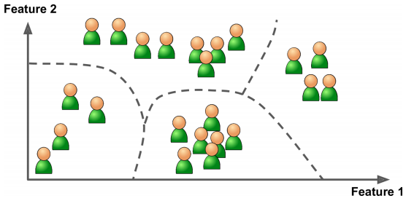
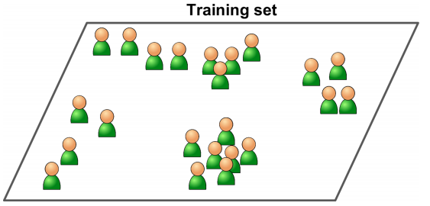
Unsupervised Learning

Slide 10
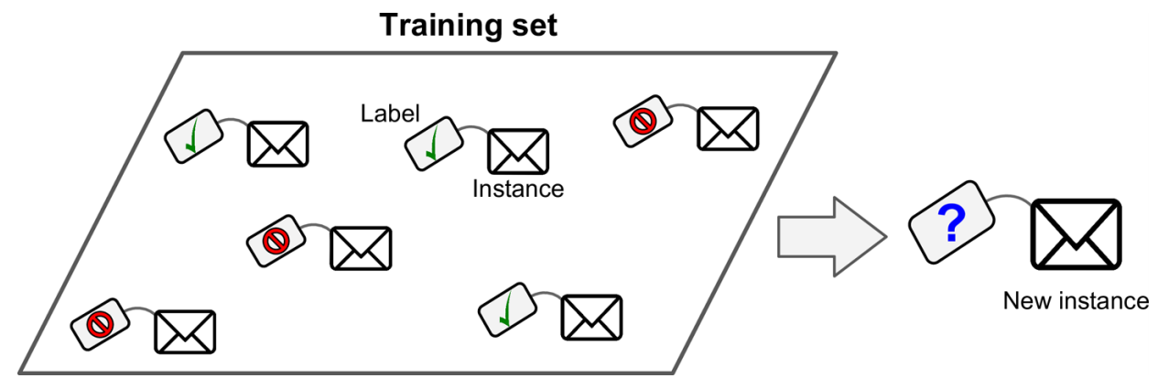
Supervised Learning
The training set you feed to the algorithm includes the desired solutions, called labels.

Slide 11
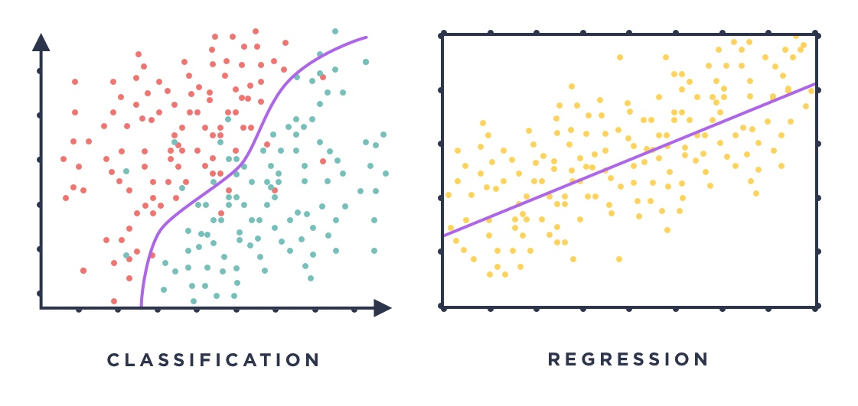
Supervised Learning sub-types

Slide 12
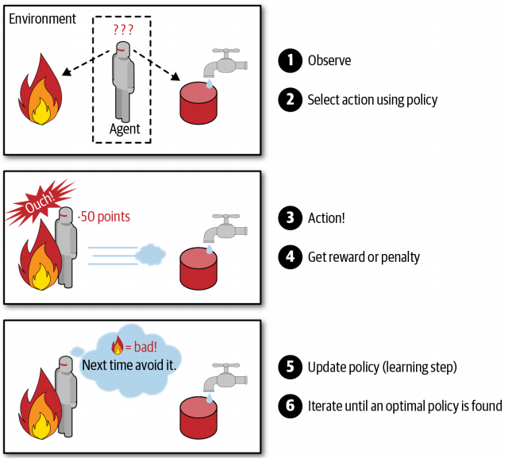
Reinforcement Learning

Slide 13
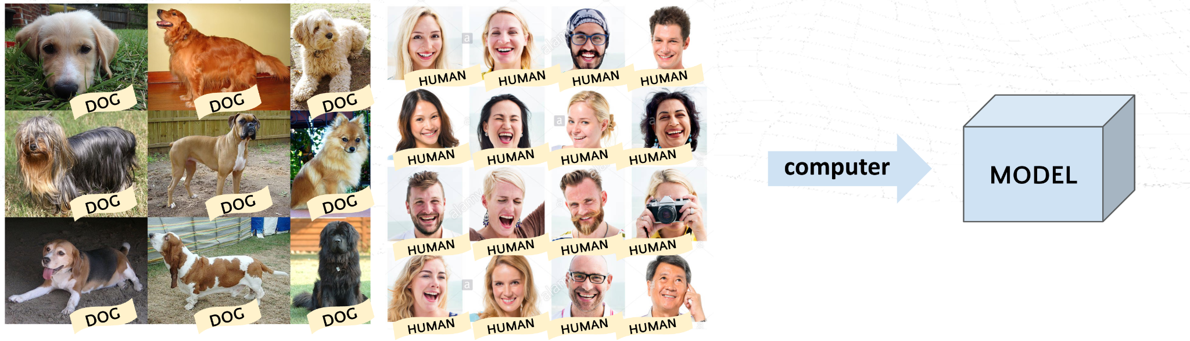
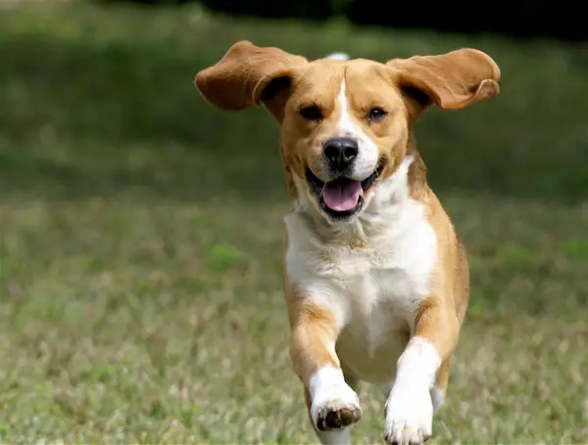
GENERALIZATION
MODEL
DOG

Slide 15
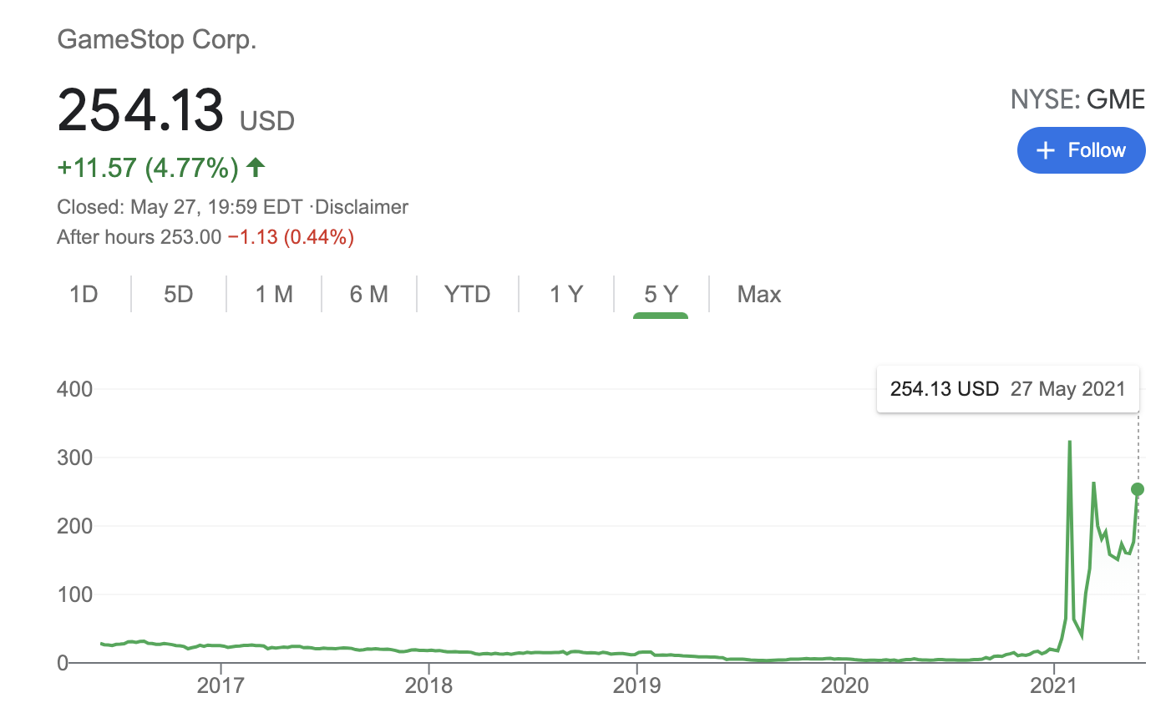
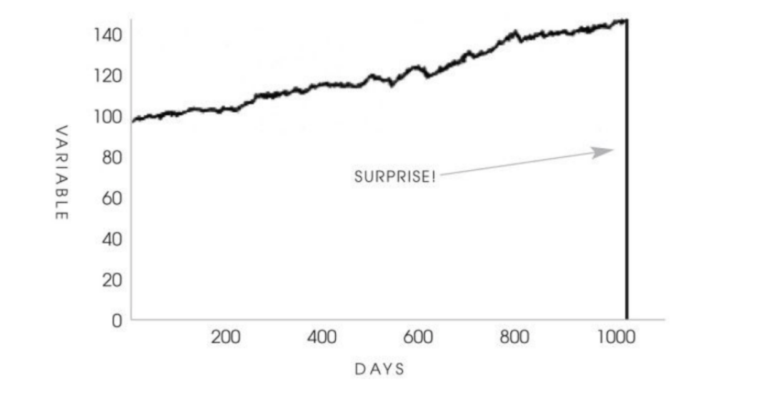
The past doesn’t always predict the future
“A turkey before and after Thanksgiving. The history of a process over a thousand days tells you nothing about what is to happen next. This naive projection of the future from the past can be applied to anything.” N. N. Tableb, The Black Swan
Notes:
From The Black Swan: “Consider a turkey that is fed every day. Every single feeding will firm up the bird’s belief that it is the general rule of life to be fed every day by friendly members of the human race “looking out for its best interests”, as a politician would say. On the afternoon of the Wednesday before Thanksgiving, something unexpected will happen to the turkey.”

Slide 16
Data splitting
Training set
(70 - 85%)
We want to have part of the data as untouched & unseen as possible to evaluate the performance of the model in conditions as similar as possible to the conditions we’ll have with completely new data.
Often, the goal of a ML model is not to be perfect, but to know where and by how much your model is wrong.
Testing set
(15-30%)
Careful with data snooping! https://medium.com/@chipk215/are-you-unknowingly-data-snooping-when-training-your-ml-models-7d6a70bdff1b

Slide 17
Cross validation
Fold 1 (20%)
Step 1 → train on red, test on blue → 80% Accuracy
Step 2 → train on red, test on blue → 90% Accuracy
Fold 2 (20%)
Step 3 → train on red, test on blue → 70% Accuracy
Training set (70 - 85% of total data)
Step 4 → train on red, test on blue → 90% Accuracy
Fold 3 (20%)
Step 5 → train on red, test on blue → 85% Accuracy
Fold 4 (20%)
Avg Accuracy = (80 + 90 + 70 + 90 + 85) / 5 = 83%
Fold 5 (20%)
Statquest explains it! https://www.youtube.com/watch?v=fSytzGwwBVw

Slide 18
imputer__strategy: [“mean”, “median”] - 2
tree__max_depth: range(5, 25, 5) - 4
tree__min_sample_split: [5, 7, 9, 11, 13, 15, 17] - 7
Combination 1: “mean”, 5, 5
Combination 2: “mean”, 5, 7
Combination 3: “mean”, 5, 9
Total combinations: 56

Slide 19
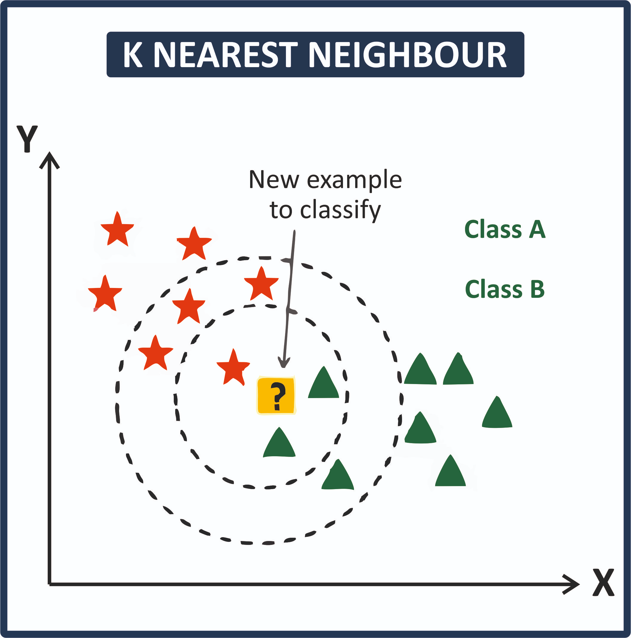
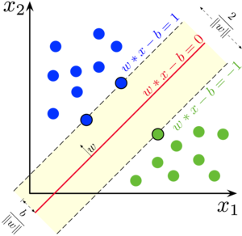
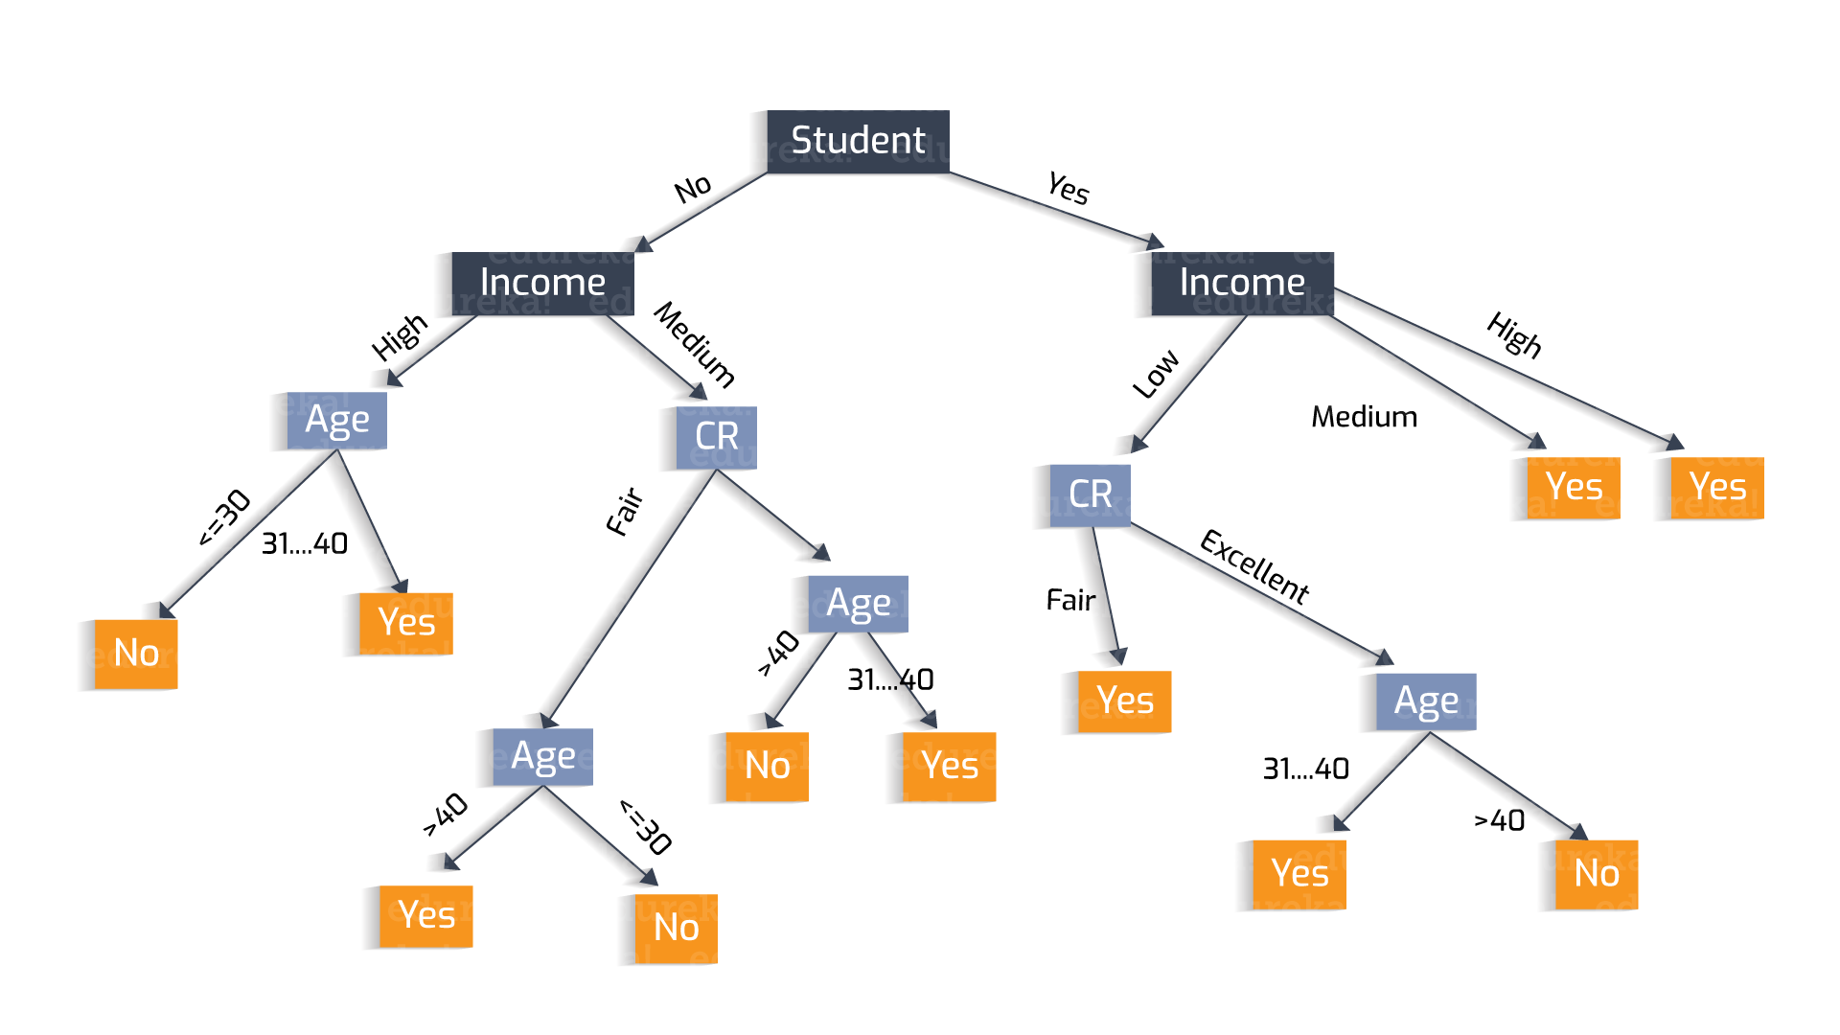
Try a bunch of models… and A LOT of parameters for each model

Slide 20
Scikit-Learn
Notes:
For machine learning programming tasks, we will mostly refer to the scikit-learn library, which is
currently one of the most popular and accessible open-source machine learning libraries.

Slide 21
Scikit-Learn basics
Installation: https://scikit-learn.org/stable/install.html#installation-instructions
Good documentation, with lots of examples and tutorials
Allows you to do stuff you don’t understand
Constantly and quickly evolving (careful with old tutorials)
You can only use their ML models and do everything else manually / with Pandas & Numpy or go full Scikit-Learn (Transformers, Pipelines…).
Notes:
The scikit-learn library offers not only a large variety of learning algorithms,
but also many convenient functions to preprocess data and to fine-tune and evaluate our models

Slide 22
The Titanic dataset
Notes:
Introduce the dataset you’ll be using in code alongs: https://www.kaggle.com/c/titanic

Slide 23
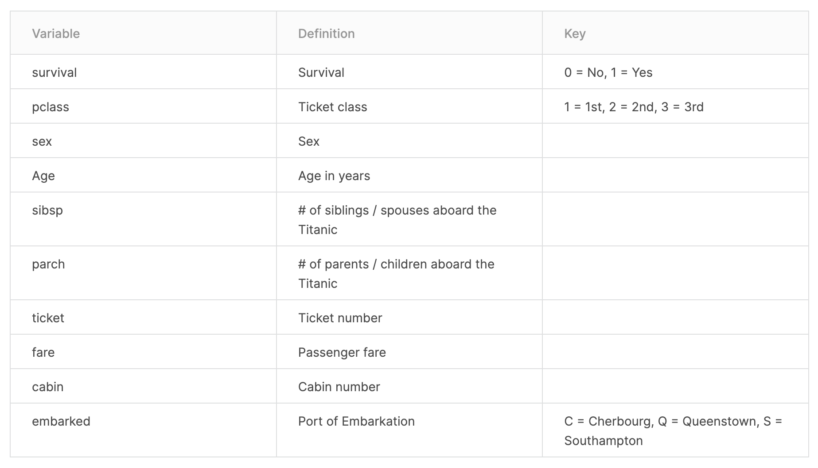

Slide 24
Variable Notes
pclass: A proxy for socio-economic status (SES)
1st = Upper
2nd = Middle
3rd = Lower
age: Age is fractional if less than 1. If the age is estimated, is it in the form of xx.5
sibsp: The dataset defines family relations in this way...
Sibling = brother, sister, stepbrother, stepsister
Spouse = husband, wife (mistresses and fiancés were ignored)
parch: The dataset defines family relations in this way...
Parent = mother, father
Child = daughter, son, stepdaughter, stepson
Some children travelled only with a nanny, therefore parch=0 for them.

